Slide 1
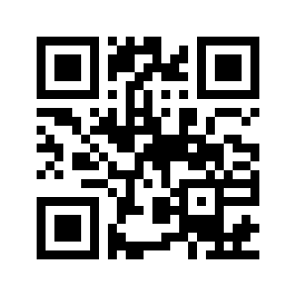



www.wossac.com
Cranfield University’s
International Soils Archive
Professor Stephen Hallett, Dr Ian Baillie
Bob Jones, Brian Kerr, Wayne Borden,
Edwin Vera
Notes:
Contact Prof S.Hallett: Email - s.hallett@cranfield.ac.uk

Slide 2
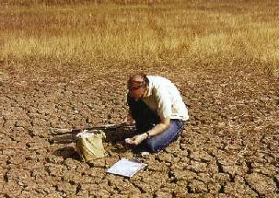
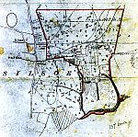
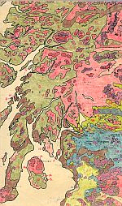
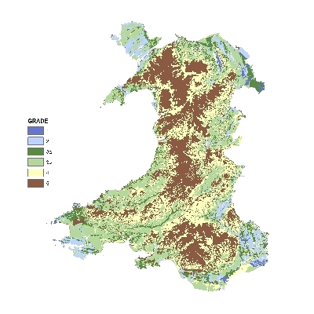
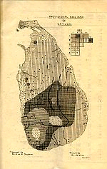

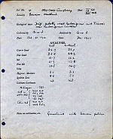
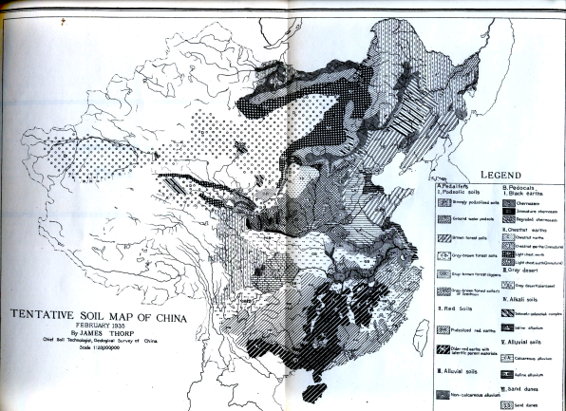
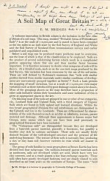
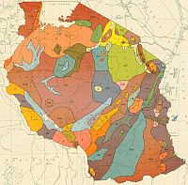
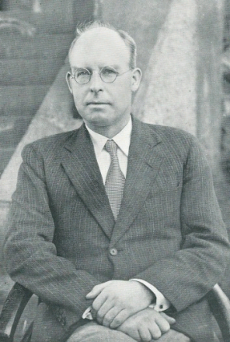
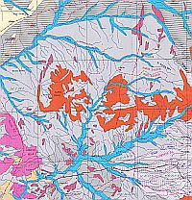
What is WOSSAC?
Notes:
WOSSAC represents a unique international resource, containing a wide range of materials that are effectively irreplaceable.

Slide 3
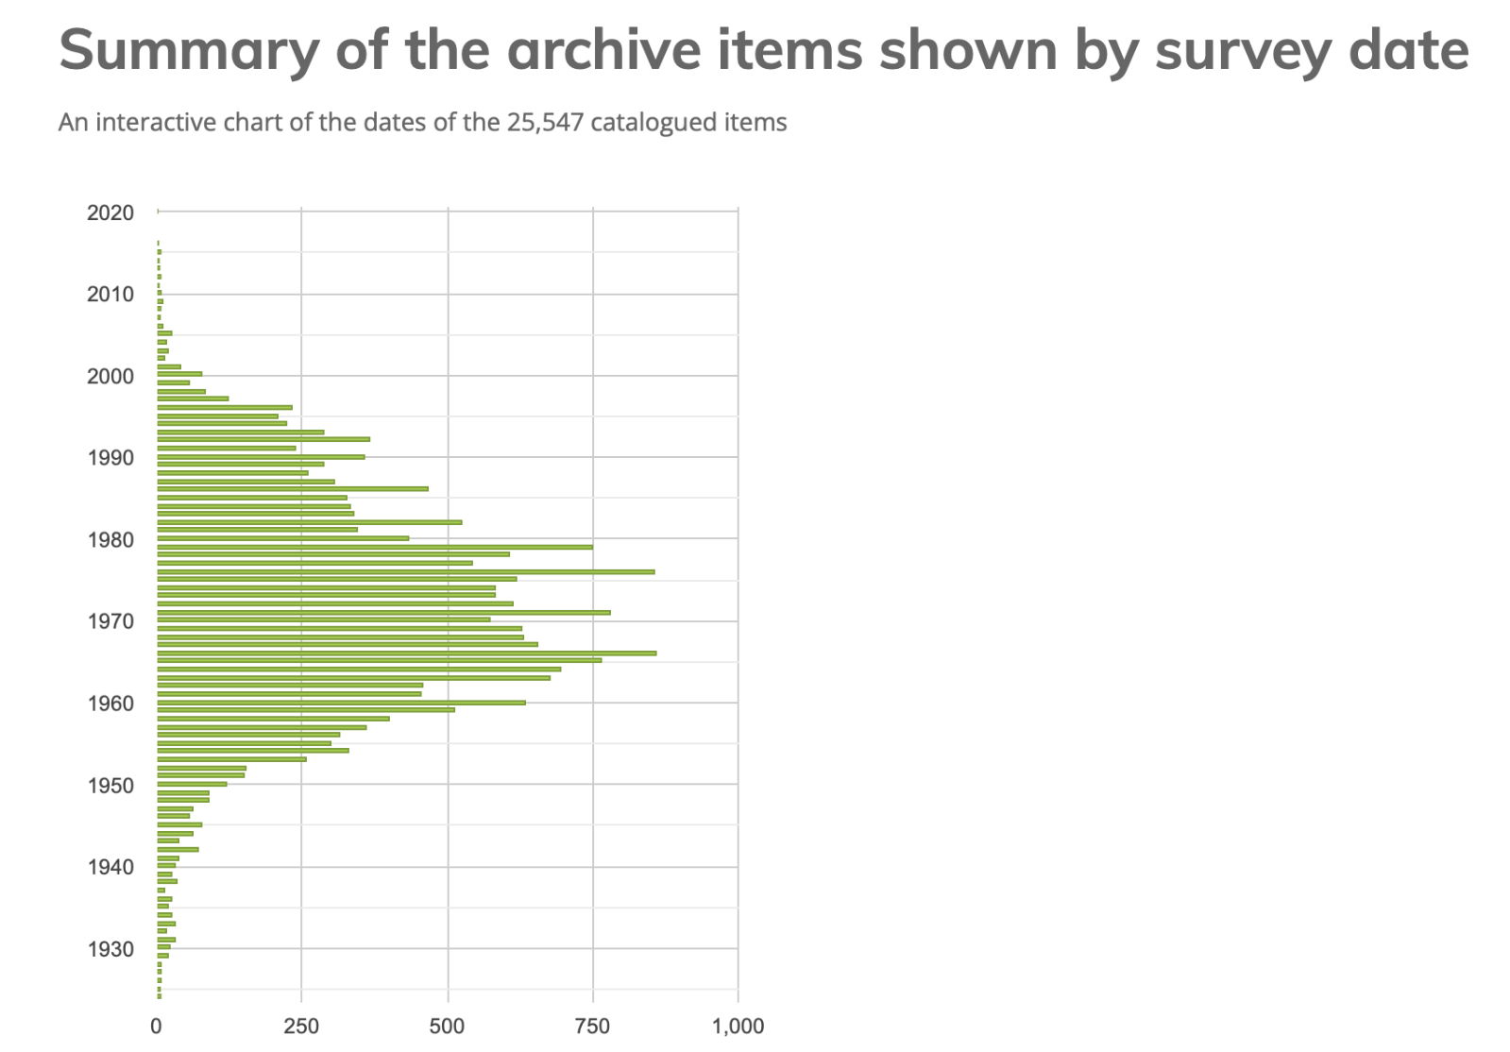
Archive holdings
25,547 items now
catalogued
12,213 georeferenced maps
73+ Contributors – organisations and individuals
Representing items from
373 + territories
Notes:
This graph of the dates of the catalogued materials shows clearly the majority of the documents were published in the early to mid 1970’s, however, there are also some very old materials in the collection and indeed materials only recently published. Note the ambition was to capture and protect ‘grey literature’.
Our ‘Inbox’ represents items yet to be catalogued – we have received a number of unique collections of soils materials now awaiting processing.
Items represent multiple ‘territories’ (noting that one territory may overlap – England, Scotland, England and Scotland = 3)

Slide 4
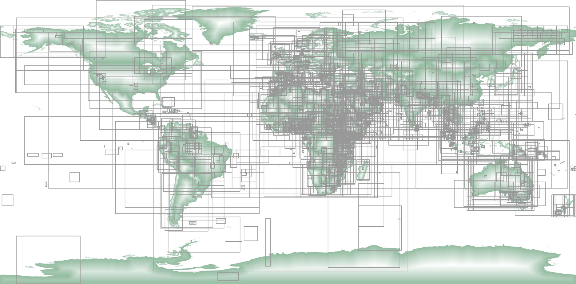
Archive holdings
Notes:
The spatial extent of holdings within the WOSSAC archive. The bounding boxes are shown for each geo-catalogued map.
The figure shows the outline of the geographical ‘bounding box’ (geographical extent) of each of the items in the WOSSAC archive for which data are available.
The figure presents a panoptic view of the geographical extent of the holdings in the archive, showing clearly the relative density of materials in Africa, Europe, the Middle East and South-East Asia.
The figure further identifies areas not well represented by the current collection, that is North and South America, Russia and Western Australia.

Slide 5
Background
Substantial numbers of soil and land surveys were
made worldwide by British companies over the past 80 years. Some 373 territories represented in collection
Surveys were originally sponsored by development assistance donors & government departments and 74 contributors
There are in WOSSAC many thousands of survey volumes and maps (25,547 items catalogued)
At today’s prices would have cost well over £200 million
Soil surveys not likely now to be repeated
Extremely valuable bank of international data about soils, their nature, properties and potential use
Current volumes may represent only existing information about the soils in many of
the countries of the world
Materials in WOSSAC had been in danger of being destroyed and lost
Notes:
WOSSAC represents a unique international resource, containing a wide range of materials that are effectively irreplaceable.
WOSSAC was a key part of the story of Cranfield’s Queens Anniversary Prize award in 2017/18, in recognition of the work of the archive.

Slide 6
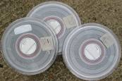
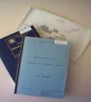
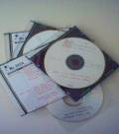

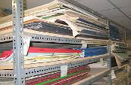
Applications
WOSSAC materials can play a role in a range of contemporary and pressing environmental issues
  Supporting the UN Sustainable Development Goals (SDG)
  Undertaking natural land and resource inventory
  Land capability assessment
  Land degradation studies
  Soil survey
  Satellite ground-truthing in fragile states
  Longitudinal environmental research
  Regional appraisal
  Disaster relief and aid planning
  Soil management
  Optimal land use suitability
  Food security
  Combating desertification
  Water use planning
  Identifying runoff
  Infiltration and water storage zones
  Waste management
  Carbon sequestration studies
Notes:
WOSSAC materials can be put to convey and support a broad spectrum of contemporary development and environmental application themes
Such as the UN SDG
Here are some example themes of application – the website contains other use cases.

Slide 7
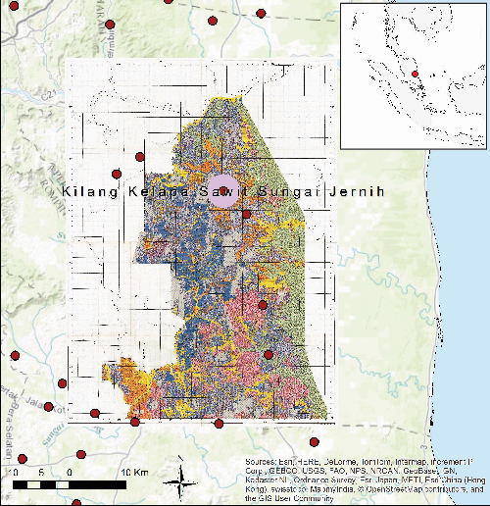
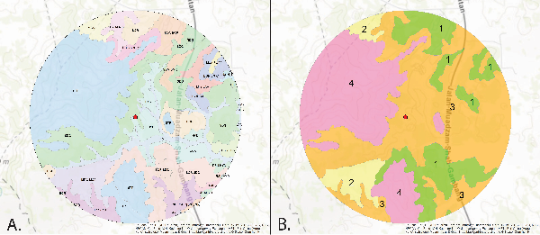
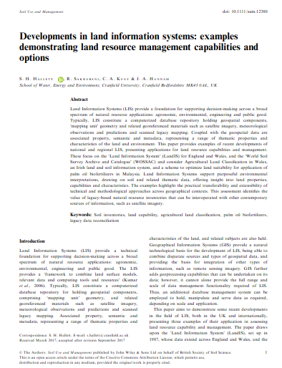
Case study application – Oil Palm
Hallett, S.H., Sakrabani, R., Keay, C.A. and Hannam, J.A. (2017) Developments in land information systems: examples demonstrating land resource management capabilities and options. Soil Use and Management. Volume 33, Issue 4, December 2017, Pages 514–529 doi: 10.1111/sum.12380. Accessed at http://onlinelibrary.wiley.com/doi/10.1111/sum.12380/full.
Notes:
The example articulates the use of the materials in WOSSAC, together with other sources of contemporary data, such as high-resolution satellite data, to identify a suitable land bank in Malaysia for the application of biofertilizers derived from palm oil.

Slide 8
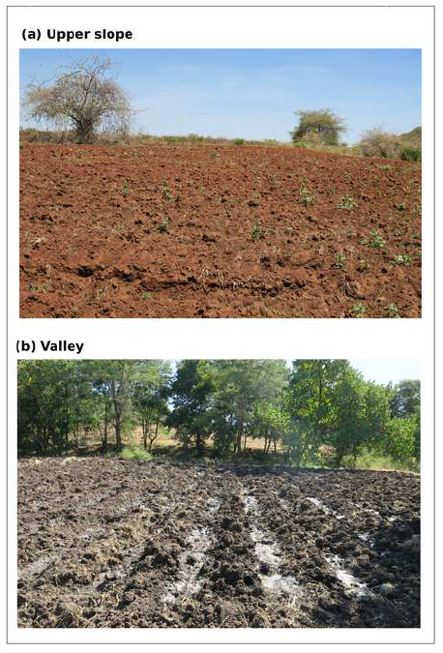
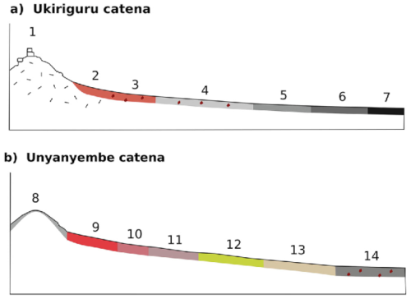
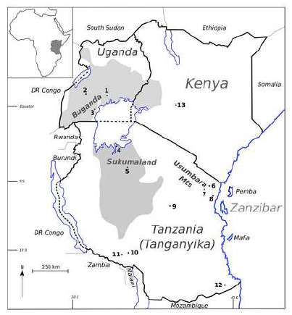
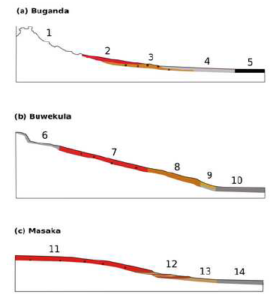
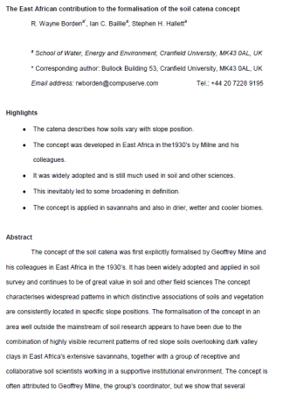
Case study research – Catenas
Borden, R.W., Baillie, I.C., Hallett, S.H. (2019) The East African contribution to the formalisation of the soil catena concept. Catena. doi.org/10.1016/j.catena.2019.104291. Accessed at https://www.sciencedirect.com/science/article/pii/S0341816219304333
Notes:
The example articulates the use of the materials in WOSSAC, together with other sources of contemporary data, such as high-resolution satellite data, to identify a suitable land bank in Malaysia for the application of biofertilizers derived from palm oil.

Slide 9
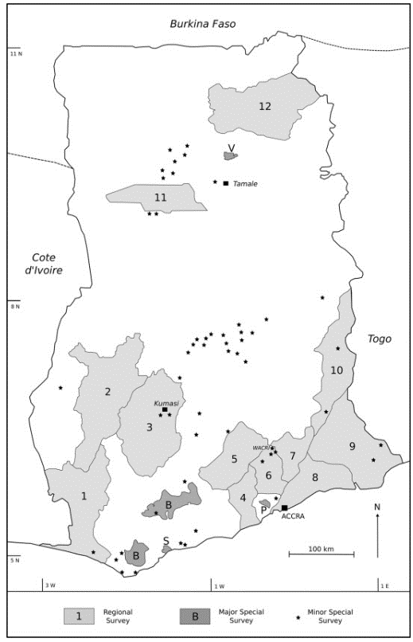
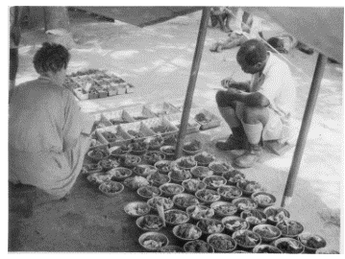
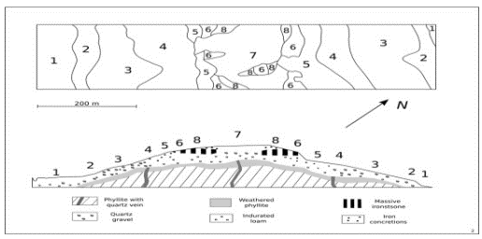
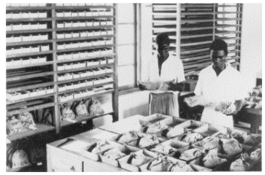
Case study research – C.E. Charter
Borden, R.W., Brammer, H., Baillie, I.C., Hallett, S.H. (2021) The contributions of C. F. Charter to tropical soil survey and classification. 197. Catena. doi.org/10.1016/j.catena.2020.104957. Accessed at https://www.sciencedirect.com/science/article/pii/S0341816220305075
Notes:
Cecil Charter pioneered soil survey in the Gold Coast after work in the Caribbean. He disaggregated the soil survey process and trained technicians for each task. The Soil Survey rapidly produced much practical and useful work of high quality. He stressed the extent of non-residual parent materials in tropical soil formation. He advocated pedogenetic classification of soils.
His work is preserved in WOSSAC

Slide 10
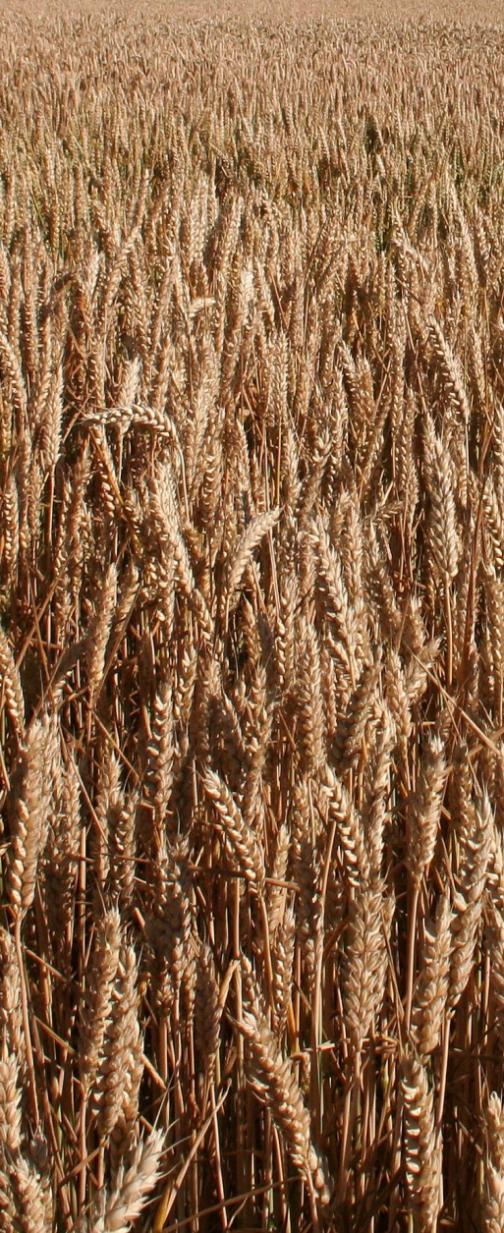
Stakeholders
WOSSAC materials are of interest to a broad range of end-users and stakeholders
  Policy makers
  Planners
  Development NGOs
  Land managers
  Agriculturalists / Agronomists
  Scientists and Researchers
  Students
  Public
Notes:
WOSSAC materials can be put to use across a broad spectrum of contemporary development and environmental actors and stakeholders
Example case studies of WOSSAC in use are presented on the website

Slide 11

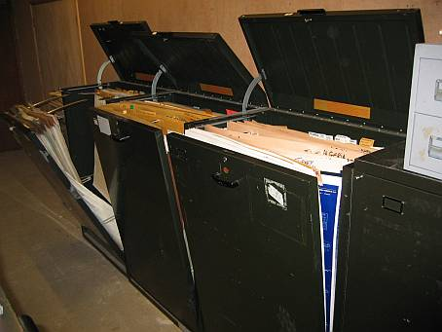
History
British Society of Soil Science (BS3)
funded 2 initial pilot projects at
Cranfield, backing University
investment
Project commenced 2004
Recruited dedicated
staff as well as body
of existing volunteer
and paid workers
2004
Notes:
The WOSSAC project first took off with the kind support of the BSSS, in 2004.

Slide 12

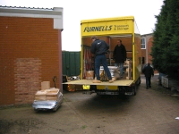
HTSPE Ltd.
Major development was the
2005 inclusion of HTSPE Collection
3,500+ Reports and associated maps
3,000+ Individual maps
Extensive Map albums
7,000+ Satellite Images
Funding for catalogue to be made
of materials
2005
Notes:
The collection has been increased by a number of substantial accessions
– none more significant that that from HTSPE Ltd.
Here are the materials from HTSPE arriving in the former Silsoe campus where WOSSAC was founded

Slide 13
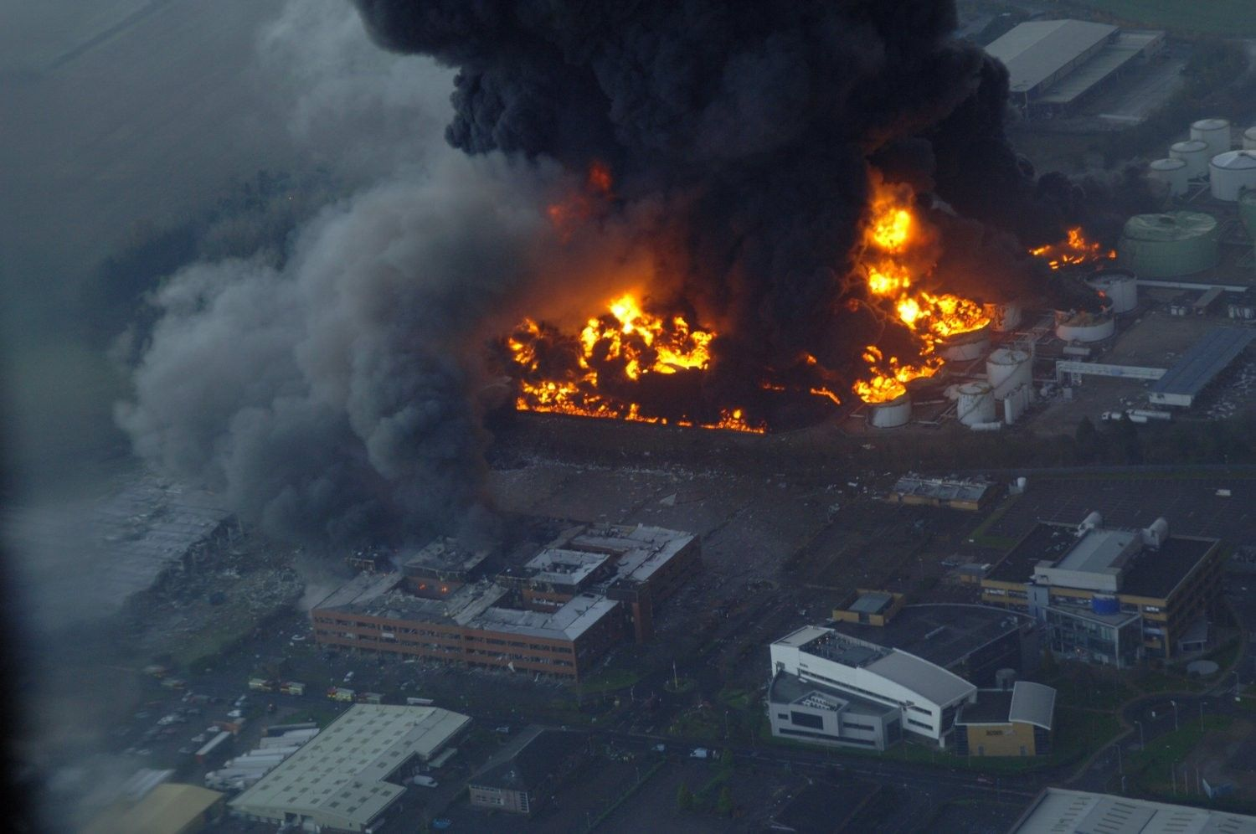
HTSPE Premises affected by Buncefield Oil disaster 11/Dec/05 – fortunately by then
HTSPE materials were safely in WOSSAC!
Notes:
We were fortunate to receive the materials from HTSPE before this explosion
– their offices were devastated (shown smoking in the foreground).
Fortunately there were no casualties from this explosion!

Slide 14
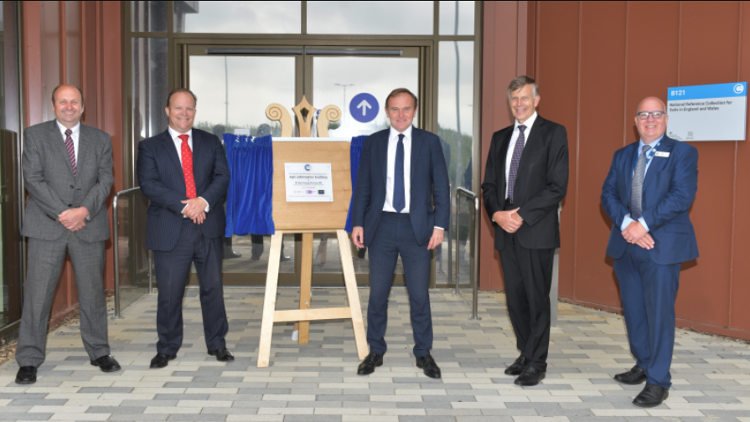
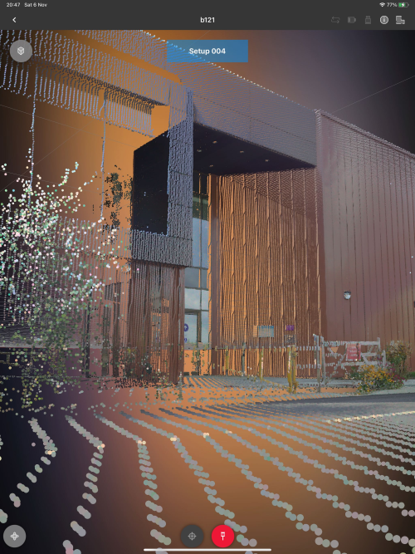
Building B121 – a new home for WOSSAC
June 2021: A new £3.2 million Agri-informatics facility was officially opened at Cranfield University by Rt Hon. George Eustice MP, the Secretary of State for Environment, Food and Rural Affairs.
Cranfield and its partners will use the facility, shared with Agri-EPI Centre, to create innovative informatics to support novel business, management and policy approaches in the agricultural sector. The new facility is the new home of the National Reference Centre for Soils and associated land information system, LandIS. The facility is also the new home for the WOSSAC archive.
Notes:
The WOSSAC holdings extend to a wide range of media types and information formats.
All are held and catalogued within the collection.
Can be described as ‘Analogue Big Data’!

Slide 15
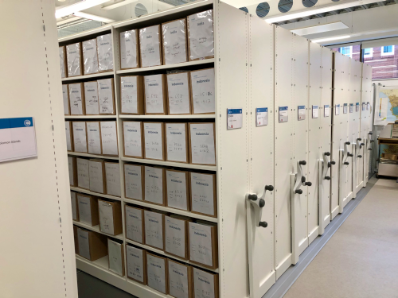
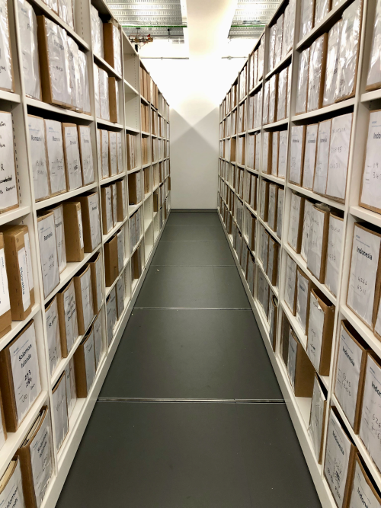
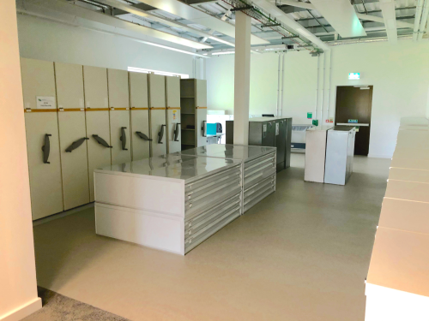
WOSSAC Holdings
Maps
Surveys
Reports
Books
Imagery
Photos…
Soil Survey
Land Use
Natural Resource
Topographical
Socio-economic
Cadastral
Notes:
The WOSSAC holdings extend to a wide range of media types and information formats.
All are held and catalogued within the collection.
Can be described as ‘Analogue Big Data’!

Slide 16
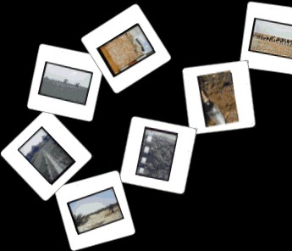
SoilPIC
‘Wiki’-based repository of soil profile and landscape photography
Dedicated website
http://www.soilsworldwide.net
Many thousands of existing slides now scanned; tens of thousands more to come
Notes:
A recent addition to the archive is the digitisation programme associated with the tens of thousands of soil profile and landscape transparencies
– a fantastic educational resource.

Slide 17
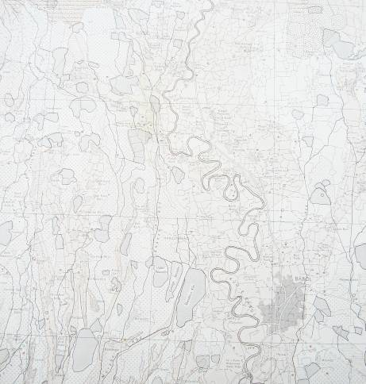
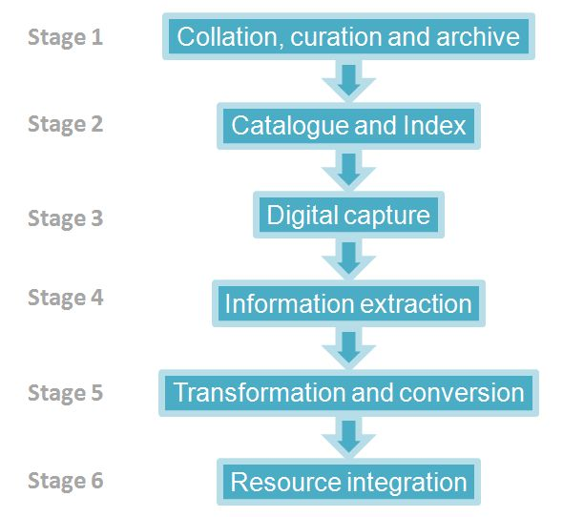
WOSSAC Programme
Successes to date
Notes:
These are the ‘big-ticket’ activities for taking the archive forward into the future.
Key is the need to link with other similar initiatives worldwide – the French, Dutch, Belgians, Portuguese, Spanish by examples from former colonies/territories.

Slide 18
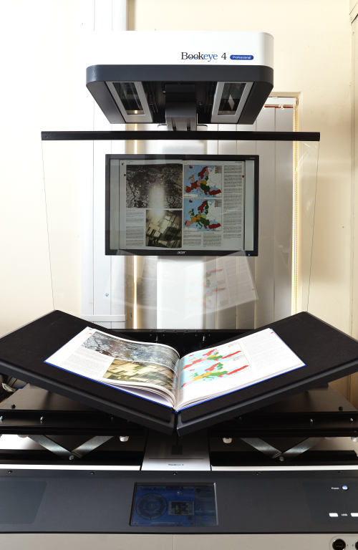
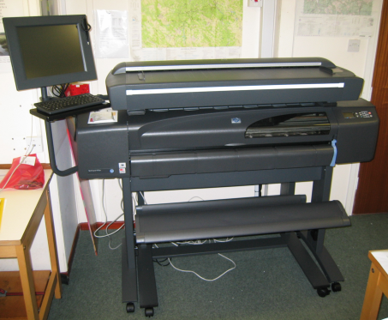
WOSSAC – Data Capture
'Ecosystem Services Databank and Visualisation for Terrestrial Informatics'(NE/L012774/1)
NERC-supported project allowing researchers and students to access, share and interact with all the natural resource, soil and land-related materials gathered from around the world in the 'World Soil Survey Archive and Catalogue', WOSSAC (www.wossac.com)
Notes:
These are the ‘big-ticket’ activities for taking the archive forward into the future.
Key is the need to link with other similar initiatives worldwide – the French, Dutch, Belgians, Portuguese, Spanish by examples from former colonies/territories.

Slide 19
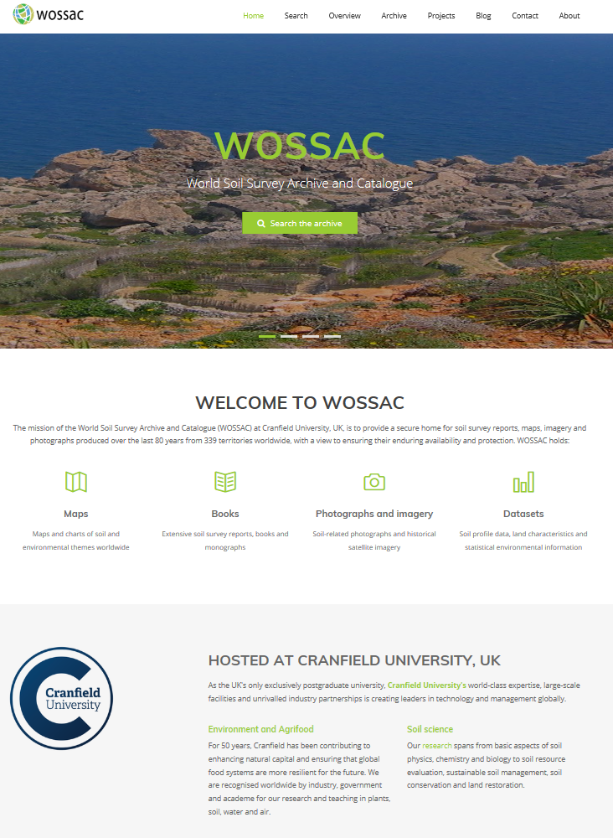
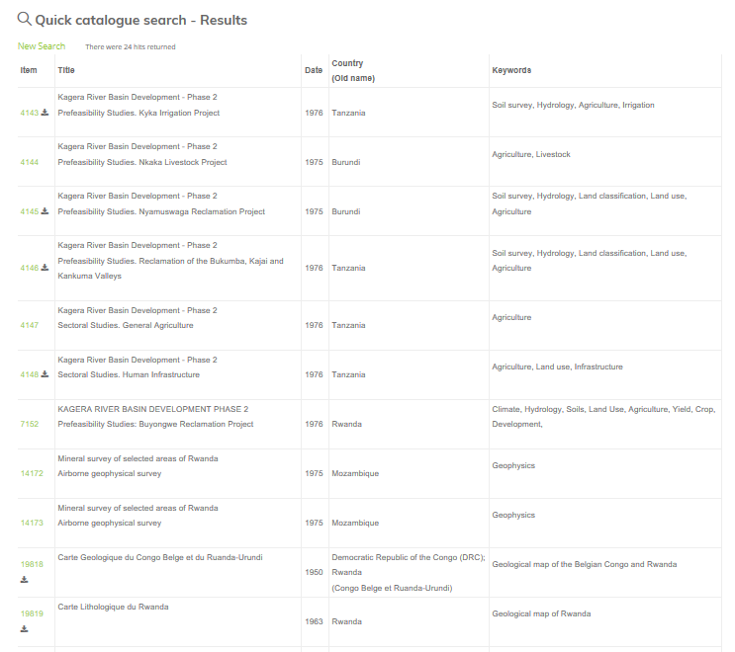
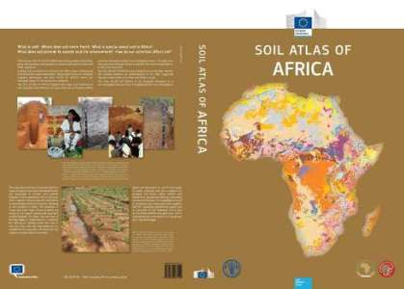
Archive Web Access
Archive items now recorded in central catalogue database,
searchable on web
Key dissemination routes
Web: www.wossac.com
Journal articles
Learned Society Bulletins
Expert users network
African Soil Atlas
Notes:
The development of the archive website at wossac.com has been a great development and boon for assisting interested parties to learn more about the archive and assessing the materials held within it.
WOSSAC was key to the EU publication of the ‘African Soil Atlas’ - https://esdac.jrc.ec.europa.eu/content/soil-map-soil-atlas-africa

Slide 20
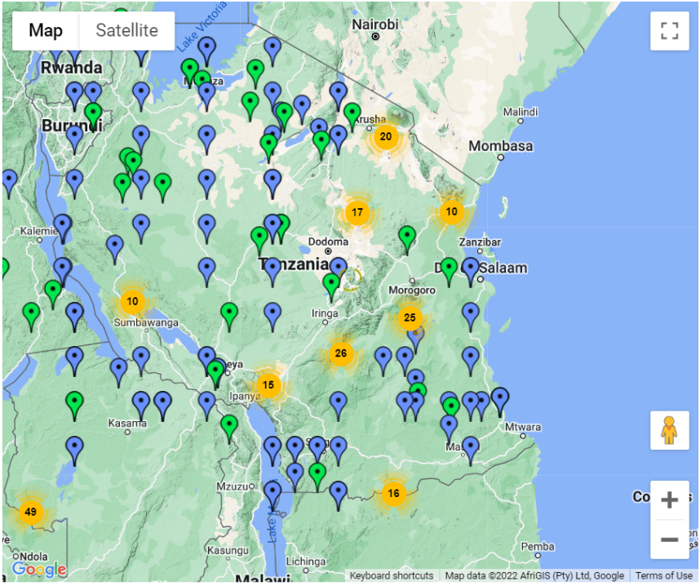
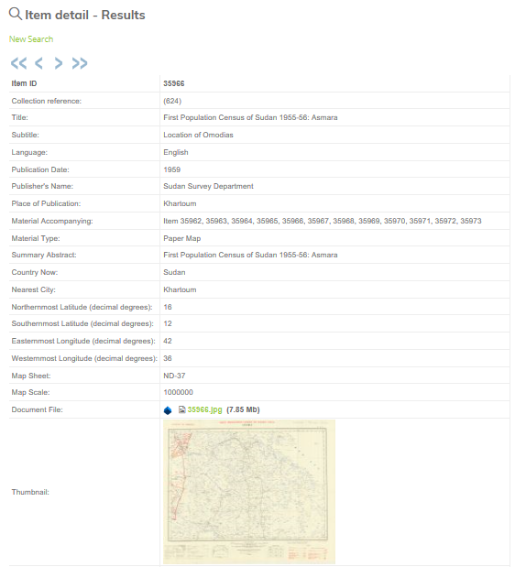
Map searches of holdings
Overview Internet mapping tool
Simple dynamic overview map with item detail summary and access if digitised
Notes:
The website allows the materials catalogues to be mapped – presenting a good overview of the spatial holdings.

Slide 21


Queens Anniversary Award - 2018
See http://www.wossac.com/blog.cfm
Notes:
SOILS FOR LIFE: PROTECTING OUR NATURAL CAPITAL
The University’s long-standing custodianship of the largest collection of soil information in Europe has fostered substantive thought-leadership in land resource management, resulting in tangible economic, policy and intellectual impact around the world for over 40 years.
The University’s unique blend of evidence-based support to a vast community of end-users for soil ‘know-how’ ensures that practical advice on land use is linked to the protection of soil assets in the national interest. The high quality soil data and expertise held by the University bring transformative economic, environmental and social benefits through better land use planning, assessment of soil degradation threats and protection of soil resources. The reach of the University’s impact extends globally by sharing this knowledge with national institutions in Europe, Africa, Asia and the Americas, to improve the valuation of soil as essential natural capital that brings economic success to individual
citizens and to society as a whole. By raising the profile of soil as a vital global resource through innovative web-based and mobile phone technologies, the University has been instrumental in exciting public interest in soil and the services it delivers.

Slide 22
2023
2021
2021
B121 opens
Inbox cleared
2019
2018
New website
Queens
Anniversary
Prize
2013
NERC Big
Data Award
2011
Capture of Sudan
Tanzania & Jordan
items
2010
2010
@Cranfield
Mass
cataloguing
2008
Move to
Cranfield starts
Mar, 2006
Oct, 2005
NRI Accessions
WOSSAC
Launch event
July, 2005
BSSS £5k grant
HTSPE £8.5k 8staff
Received HTSPE &
SRI Accessions
HTSPE Phase 2
£6k 4staff
Jan, 2005
Mar, 2005
Website ready
(wossac.com)
Mar, 2004
Jan, 2004
Formal project
commencement;
Meet British Library
Cranfield Library
MAGIC meetings
Sept, 2003
May, 2003
BSSS £10k grant
Archivist employed
Advised by
Cranfield library
Notes:
A long and winding road – but a huge testament to the dedication and work of the archive team.

Slide 23
The Future …
1.
Secure this precious collection of maps, reports and digital media
  Corresponding with other UK sources
Develop the growing research base of WOSSAC users
  Doctoral and Masters students world-wide, re-patriate data
Undertake research to improve remote access and application of collection
  Scanning and PDF impressions of holdings, OCR text, web services…
Develop links to the 5 major holders of similar information, forming a global archive of soils information: ISRIC, IRD, ESB, FAO, USDA
2.
3.
4.
The issue as ever is securing funding support for these activities

Slide 24
Notes:
WOSSAC represents a unique international resource, containing a wide range of materials that are effectively irreplaceable.

